Slide 1

My Project
Author: Peter Lucan
Supervisor: Chris Meudec
Date: 19/12/2020

Slide 2
Application Green Quake
Behavioral, social and cultural change for the Green Deal
By making being environmentally friendly Easier and Fun to do.

Slide 3
3 Sections
Gamification of eco friendly activities
Water Refill Station Tool
Food Tracker Tool

Slide 4
2 Versions
Public Standard Version
Company Version

Slide 5

Target Audience
People who want to be environmentally friendly but need some help
Companies who wish to be environmentally friendly

Slide 6
Tools and Technologies
Xamarin Forms and C#, JSON, Firebase
Visual Studio 2019, GitHub, Windows, Android and iOS

Slide 7

App Demo

Slide 8
Remaining Work
Finish Basic Designs
01
Finish Database Design
02
Implement the Basic Designs and the functionality of the app
03
Improve the UX Designs
04
Implement the UX Designs
05
Test the App
06

Slide 9
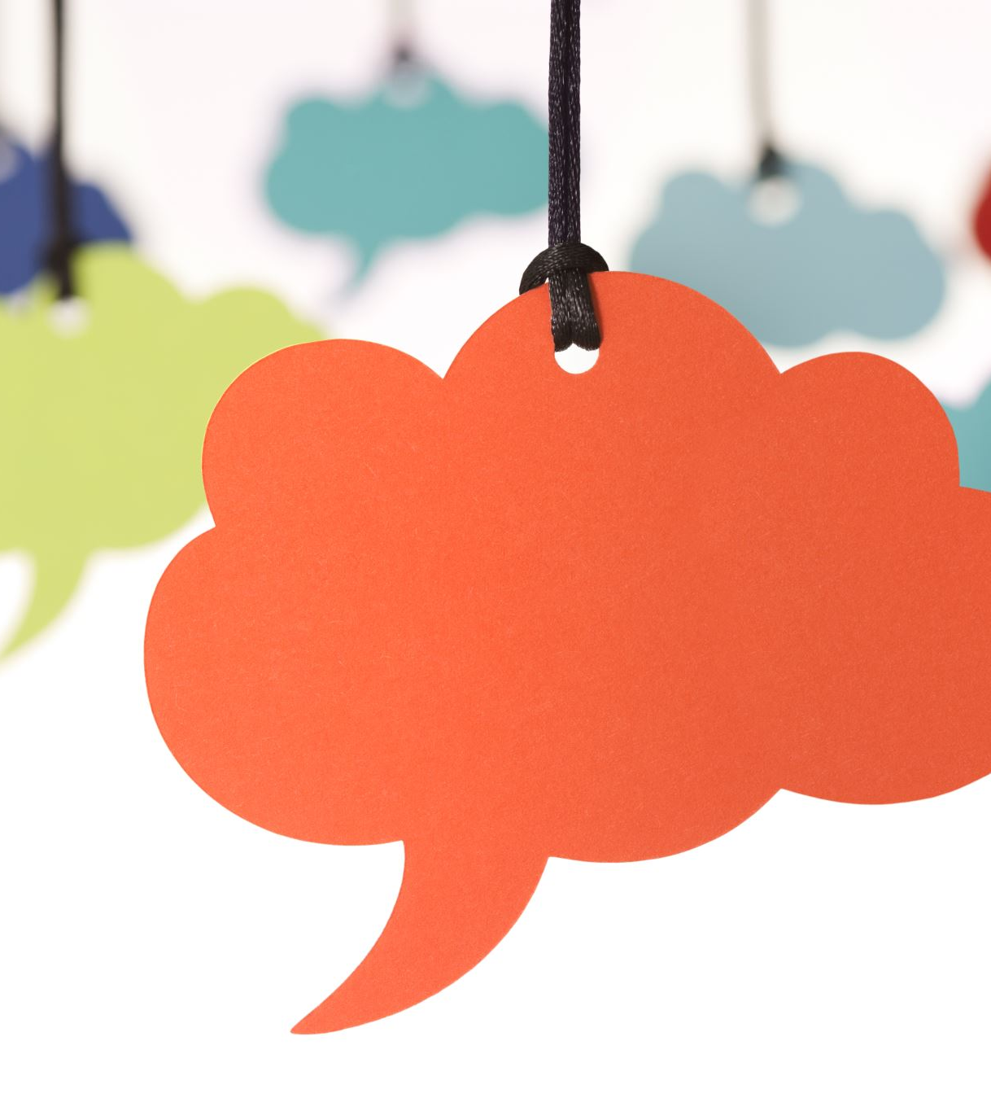
Thank You For Listening
Any Questions?

